Slide 1
Japanese-Chinese Phrase Alignment Exploiting Shared Chinese Characters
Chenhui Chu, Toshiaki Nakazawa and Sadao Kurohashi
Graduate School of Informatics, Kyoto University
NLP2012 (2012/03/14)

Slide 2
Outline
Motivation
Shared Chinese Characters
Exploiting Shared Chinese Characters
Experiments
Conclusion and Future Work

Slide 3
Outline
Motivation
Shared Chinese Characters
Exploiting Shared Chinese Characters
Experiments
Conclusion and Future Work

Slide 4
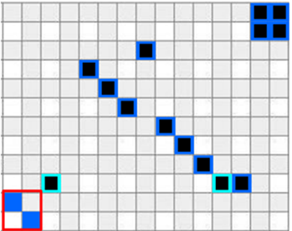
Chinese Characters in Alignment
可以
说
公式
(
2
)
的
标准
E
满足
该
Sure alignment
规定
Possible alignment
规定
そ
の
規
準
を
,
(
2
)
式
の
尺
度
E
は
満
た
す
と
言
え
る
Automatic alignment
規
準

Slide 5
Outline
Introduction
Shared Chinese Characters
Exploiting Shared Chinese Characters
Experiments
Conclusion and Future Work

Slide 6
Chinese Characters Shared in Japanese and Chinese
Common Chinese characters (Chu et al., 2011)
Can be detected using freely available database
“愛”⇔“爱”/“love”, “発”⇔“发”/“begin”…
Other semantically equivalent Chinese characters
“食”⇔“吃”/“eat”, “隠”⇔“藏”/“hide”…

Slide 7
Common Chinese Characters Database (Chu et al., 2011)
 | Identical | Variants
Kanji | 雪(U+96EA) | 国(U+56FD) | 愛(U+611B) | 浄(U+6D44) | 県(U+770C)
Traditional Chinese | 雪(U+96EA) | 國(U+570B) | 愛(U+611B) | 凈(U+51C8) | 縣(U+7E23)
Simplified Chinese | 雪(U+96EA) | 国(U+56FD) | 爱(U+7231) | 净(U+51C0) | 县(U+53BF)
3,141 chars
+2,514 chars
+42 chars
+12 chars
Unihan Database
Chinese
Converter
Kanconvit
※Repository of CJK
Unified Ideographs
※Traditional Chinese
& Simplified Chinese
Converter
※Kanji & Simplified
Chinese Converter

Slide 8
Other Semantically Equivalent Chinese Characters
There are no available resources
Statistical method to calculate statistically equivalent Chinese characters
Meaning | eat | word | hide | look | day
Kanji | 食(U+98DF) | 語(U+8A9E) | 隠(U+96A0) | 見(U+898B) | 日(U+65E5)
Traditional Chinese | 吃(U+5403) | 詞(U+8A5E) | 藏(U+85CF) | 看(U+770B) | 天(U+5929)
Simplified Chinese | 吃(U+5403) | 词(U+8BCD) | 藏(U+85CF) | 看(U+770B) | 天(U+5929)

Slide 9
Statistically Equivalent Chinese Characters Calculation
Ja:
重大な情報が隠されている
Zh:
隐藏着重要的信息
Ja:
重
大
情
報
隠
Zh:
隐
藏
着
重
要
的
信
息

Slide 10
Lexical Translation Probability Estimated by Character-Based Alignment Using GIZA++
f_{i} | e_{j} | t(e_{j}|f_{i}) | t(f_{i}|e_{j})
隠 | 隐 | 0.287 | 0.352
重 | 重 | 0.572 | 0.797
隠 | 藏 | 0.122 | 0.006
大 | 藏 | < 1.0e-07 | 5.07e-06
情 | 信 | 0.796 | 0.634
報 | 息 | 0.590 | 0.981
“隠”⇔“藏”/“hide”
“情報” ⇔“信息”/“information”
“情” ⇔“信” & “報” ⇔“息”
may be problematic in other domains
Notes:
We keep “情” ⇔“信” & “報” ⇔“息”

Slide 11
Outline
Motivation
Shared Chinese Characters
Exploiting Shared Chinese Characters
Experiments
Conclusion and Future Work

Slide 12
Bayesian Sub-tree Alignment Model (Nakazawa and Kurohashi, 2011)
Step 1
Step 3
Step 2
彼
他
C₁
は
是
C₂
です
私
我
C₃
の
哥哥
C₄
兄

Slide 13
Exploiting Shared Chinese Characters
α: a value set by hand,
5,000 in experiment
shared Chinese characters
matching ratio

Slide 14
Shared Chinese Characters Matching Ratio
matching weight of Chinese characters in phrase
Common: 1, Statistically equivalent: highest Lexical
Translation Probability
number of Chinese characters in phrase
Notes:
Numerator and denominator

Slide 15
Outline
Motivation
Shared Chinese Characters
Exploiting Shared Chinese Characters
Experiments
Conclusion and Future Work

Slide 16
Alignment Experiment
Training: Ja-Zh paper abstract corpus (680k)
Testing: about 500 hand-annotated parallel sentences (with Sure and Possible alignments)
Measure: Precision, Recall, Alignment Error Rate
Japanese Tools: JUMAN and KNP
Chinese Tools: MMA and CNP (from NICT)
Notes:
Character-based alignment are trained on the same corpus

Slide 17
Experimental Results
 | Precision | Recall | AER
GIZA++(grow-diag-final-and) | 83.77 | 75.38 | 20.39
BerkelyAligner | 88.43 | 69.77 | 21.60
Baseline(Nakazawa+ 2011) | 85.37 | 75.24 | 19.66
+Common | 85.55 | 76.54 | 18.90
+Common & SE | 85.22 | 77.31 | 18.65
SE: Statistically equivalent

Slide 18
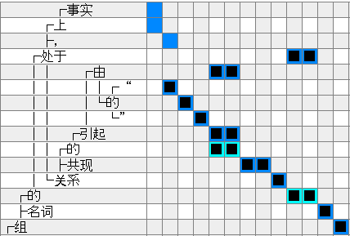
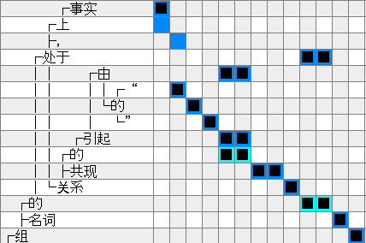
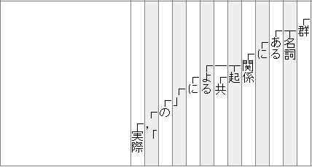
Improved Example by Common Chinese Characters
事实
実
際
Baseline
Proposed

Slide 19
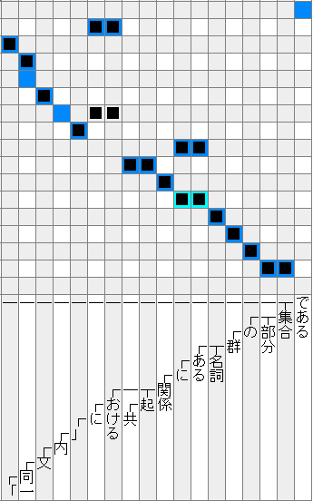
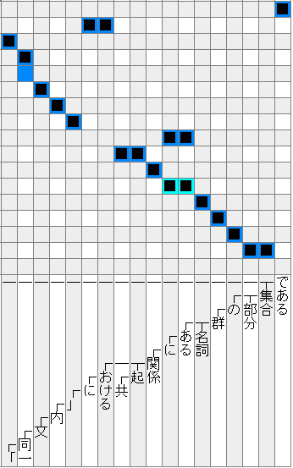
Improved Example by Statistically Equivalent Chinese Characters
中
Baseline
Proposed
内

Slide 20
Translation Experiment
Training: Ja-Zh paper abstract corpus (680k)
Testing: 1,768 sentences from the same domain as the training corpus
Decoder: Kyoto example-based machine translation (EBMT) system (Nakazawa and Kurohashi, 2011)

Slide 21
Experimental Results
BLEU | Ja-to-Zh | Zh-to-Ja
Baseline(Nakazawa+ 2011) | 19.10 | 22.84
+Common | 19.22 | 23.14
+Common & SE | 19.25 | 23.22
SE: Statistically equivalent

Slide 22
Outline
Introduction
Shared Chinese Characters
Detection Method
Exploiting Shared Chinese Characters
Experiments
Conclusion and Future Work

Slide 23
Conclusion
We proposed a method for detecting statistically equivalent Chinese characters
We exploited statistically equivalent Chinese characters together with common Chinese characters in a joint phrase alignment model
Our proposed approach improved alignment accuracy as well as translation quality

Slide 24
Future Work
Evaluate the proposed approach on parallel corpus of other domains

