Slide 1
Iterative Bilingual Lexicon Extraction from Comparable Corpora Using Topic Model and Context Based Methods
Chenhui Chu, Toshiaki Nakazawa, Sadao Kurohashi
Graduate School of Informatics, Kyoto University
NLP2014 (2014/03/20)

Slide 2
Background
Bilingual lexicons are important for many bilingual NLP tasks, such as SMT and CLIR
Manual construction is expensive and time-consuming
Automatic construction from parallel corpora is a possible way, however parallel corpora remain a scarce resource
Automatic construction from comparable corpora

Slide 3
Bilingual Lexicons in Comparable Corpora
Zh:
．．．
市场经济，又称自由市场经济，是一种经济体系，在这种体系下产品和服务的生产及销售完全由自由市场的自由价格机制所引导，而不是像计划经济一般由国家所引导。市场经济也被用作资本主义的同义词，但是绝大多数的社会主义国家也实行了市场经济。
．．．
．．．
A market economy is an economy in which decisions regarding investment, production and distribution are based on supply and demand, and prices of goods and services are determined in a free price system. The major defining characteristic of a market economy is that decisions on
．．．
En:
※ Example of comparable texts describing “market economy” from Wikipedia (Bilingual lexicons are linked with bleu lines).
Notes:
Comparable Corpora are topic-aligned bilingual texts, which are not exact translation equivalents of each other. However, there can be parallel data contained in the comparable texts. This figure shows an example of Chinese-Japanese comparable texts describing “Japan” from Wikipedia. We can see that there are tree types of parallel data: parallel sentences, fragments and bilingual lexicons in the comparable texts. Comparable corpora are far more available, in this study we aim to extract the parallel data from comparable corpora to improve MT.

Slide 4
Related Work
Topic Model Based Method [Vulic+ 2011]
Bilingual lexicons often present in the same cross-lingual topics (document-level context)
Does not require any prior knowledge
Context Based Method [Rapp+ 1999]
Bilingual lexicons appear in similar contexts across languages (usually window-based context)
Require a seed dictionary

Slide 5
System Overview
Unsupervised
Seed
Dictionary
Seed
Dictionary
Topical bilingual lexicons
Topic model based method
市场
(market)
company
market
consumer
0.0626
0.0600
0.0474
Combined bilingual lexicons
・・・
・・・
Combination
市场
(market)
market
company
consumer
0.0616
0.0612
0.0547
consumer
market
company
0.0840
0.0680
0.0557
・・・
・・・
Context based method
市场
(market)
Comparable corpora
・・・
・・・
Contextual bilingual lexicons
Iteration
Notes:
This is an overview of our bilingual lexicon extraction system. The system is a novel combination of topic model and context based methods. From comparable corpora, we first generate topical bilingual lexicons using topic model based method, which is unsupervised. The topical bilingual lexicons contain a ranked list of translation candidates for a source word wiS, where a target word wjT in the list has a topical similarity score SimTopic. Then using the topical bilingual lexicons as seed dictionary, we apply context based method to generate contextual bilingual lexicons. Next we combine these two lexicons. Since the quality of the combined bilingual lexicon will become better, we use the combined lexicon as seed dictionary and apply the context based method and combination iteratively. I will explain topic model based method, context based method and combination in detail.

Slide 6
Topic Model Based Method
Topic distribution
Word–topic distributions
z
w
M^{S}
φ
α
θ
β
z
w
M^{T}
ψ
K
D
Sim=0.0626
市场: <T1: 0.0138, T2: 0.0087, T3: 0.0004, T4: 0.0102・・・>
Sim=0.0600
company: <T1: 0.0054, T2: 0.0120, T3: 0.0014, T4: 0.0089・・・>
market: <T1: 0.0029, T2: 0.0039, T3: 0.0251, T4: 0.0081・・・>
Sim=0.0474
consumer: <T1: 0.0028, T2: 0.0009, T3: 0.0058, T4: 0.0037・・・>
Notes:
Context based method first constructs a context vector of a source word from source monolingual corpora. Each dimension in the context vector contains a context word and its association score between the source word. Here shows a context vector of Chinese word “市场”. Then we project this source context vector to the target side via a seed dictionary, and get a projected context vector. We construct context vectors of target words from target monolingual corpora in the same manner, and compute the contextual similarity score between the projected context vector and the target vectors to identify its translation.

Slide 7
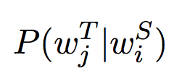
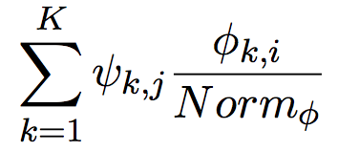
Similarity Measure
TI:
Cue:
TI+Cue:
Notes:
TF–ITF score is computed in a word–topic space, which is similar to TF–IDF score that is computed in a word–document space.
The Cue measure is the probability P (wjT |wiS ), where wjT and wiS are linked via the shared topic space

Slide 8
Context Based Method
市场: <规律: 24.9, 系统: 38.4, 厂: 8.9, 饮料: 22.2・・・>
(projection via a seed dictionary)
市场:<law: 24.9, system: 38.4, factory: 8.9, drink: 22.2・・・>
Sim=0.0840
Sim=0.0680
consumer: <law: 23.5, system: 38.3, factory: 10.2, drink: 21.8・・・>
market: <law: 14.6, system: 31.2, factory: 3.7, drink: 22.8・・・>
Sim=0.0557
company: <law: 64.0, system: 18.7, factory: 1.9, drink: 11.4・・・>
Notes:
Context based method first constructs a context vector of a source word from source monolingual corpora. Each dimension in the context vector contains a context word and its association score between the source word. Here shows a context vector of Chinese word “市场”. Then we project this source context vector to the target side via a seed dictionary, and get a projected context vector. We construct context vectors of target words from target monolingual corpora in the same manner, and compute the contextual similarity score between the projected context vector and the target vectors to identify its translation.

Slide 9
Context Modeling and Similarity
Window-based context (±2)
e.g.
Cosine similarity
mainstream drink factory market law system sellers exchange goods services information

Slide 10
Combination
Combined similarity score
Topical bilingual lexicons
Contextual bilingual lexicons
Combined bilingual lexicons
0.8 ×
company
market
consumer
0.0626
0.0600
0.0474
+ 0.2 ×
consumer
market
company
0.0840
0.0680
0.0557
=
market
company
consumer
0.0616
0.0612
0.0547
市场
(market)
市场
(market)
市场
(market)
・・・
・・・
・・・
・・・
・・・
・・・
Notes:
We use a linear combination for the two methods to calculate a combined similarity score. The linear interpolation parameterγis empirically determined. Note that we only keep the Top-N translation candidates for a source word during all the steps. Thus, a combination example will be like this.

Slide 11
Experimental Settings
Dataset: 10k Zh-En and Ja-En Wikipedia article pairs via the interlanguage links (kept only lemmatized nouns)
BiLDA topic model training: PolyLDA++ [Richardson+ 2013]
α = 50/K, β = 0.01, Gibbs sampling with 1k iterations
TI+Cue measure: BLETM [Vulic+ 2011]
Proposed method
Linear interpolation parameter γ = 0.8, 20 iterations
Evaluation: manually created Zh-En and Ja-En test sets for the most frequent 1k source words

Slide 12
Results (Chinese-English Precision@1)
Precision@1
Iteration

Slide 13
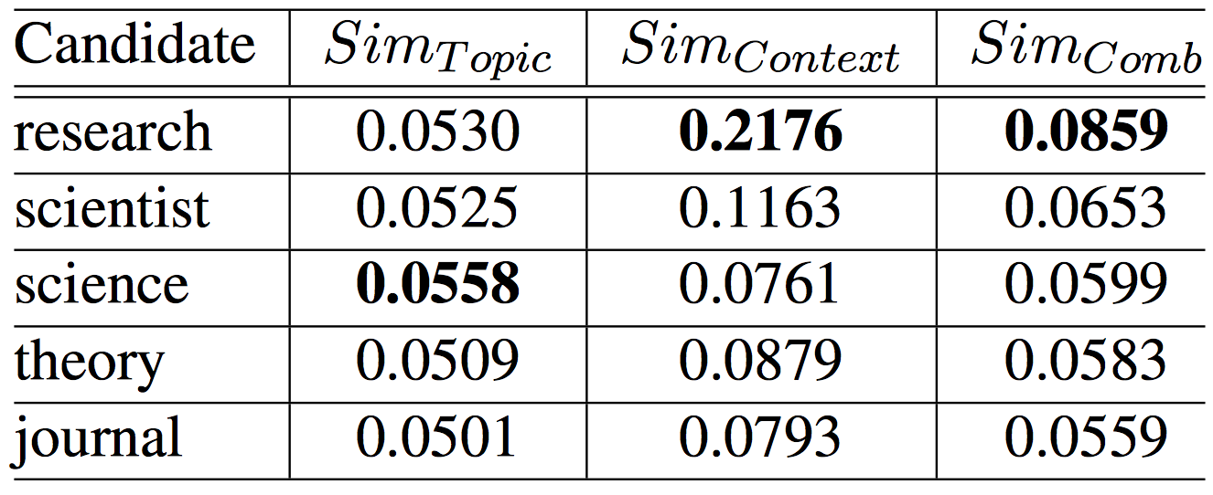
Improved Example
※ An improved example of word 研究 (research), where topical similarity scores are similar, while contextual similarity scores are distinguishable

Slide 14
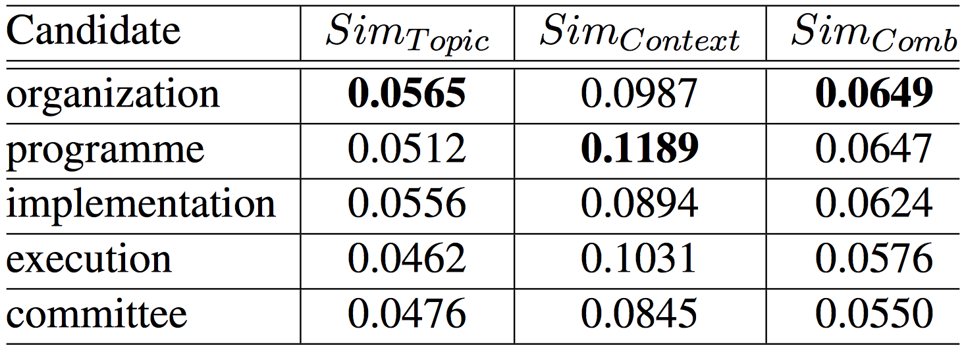
Not Improved Example
※ An improved example of word 执行 (execution), where linear combination of the two scores is not discriminative enough

Slide 15
Conclusion
Proposed a bilingual lexicon extraction system exploiting both topical and contextual knowledge in an iterative process
Experiments on Wikipedia data verified the effectiveness of our system
Software and dataset is freely available at:
http://orchid.kuee.kyoto-u.ac.jp/~chu/code/iBiLexExtractor.tgz
Future work
Extraction for polysemy, compound nouns and rare words

