Slide 1
Improving Statistical Machine Translation Accuracy Using Bilingual Lexicon Extraction with Paraphrases
Chenhui Chu, Toshiaki Nakazawa, Sadao Kurohashi
Graduate School of Informatics, Kyoto University
PACLIC2014 (2014/12/12)

Slide 2
Statistical Machine Translation (SMT) [Brown+ 1993]
Zh:
#1:今年，这种主导作用依然非常突出。
#2: （国际）巴西国家风险指数下降。
．．．
#1: This year, the leading role played by this sector remains strong.
#2: (International) Brazil 's risk index drops.
．．．
En:
Translation model
Input:
人类共有二十三对染色体。
Output:
Humans have a total of 23 pairs of chromosomes.
Language model
Decoder
Rapid development of MT systems for different language pairs and domains is possible, once parallel corpora are available
Notes:
Magic. In corpus based machine translation, because translation knowledge is acquired from parallel corpora, the quality and quantity of parallel corpora are crucial. Parallel corpora are sentence-aligned bilingual texts. This shows an example of a Chinese-Japanese parallel corpus. From this parallel corpus, we train a translation model, and conduct translation. However, except for a few language pairs and domains, parallel corpora remain a scarce resource.

Slide 3
Scarceness of Parallel Corpora
Limitations in previous studies for parallel corpora construction
Richness of languages
There are about 7,000 languages in the world, and it is difficult to construct for every language pair
Domain diversity
Construct in every domain is not an easy task, even for the language pairs that have rich resources

Slide 4
Problems Caused by Scarceness of Parallel Corpora
The coverage problem
Scarceness makes the coverage of the translation model low, leading to high out of vocabulary (OOV) word rates [Callison-Burch+ 2006]
It also occurs when the domain shifts [Irvine+ 2013]
The accuracy problem (Focus of this study)
The quality of the translation model correlates with the quality and quantity of parallel corpora, and scarceness makes it inaccurate [Irvine+ 2013]

Slide 5
Phrase-based SMT [Koehn+ 2003]
Source sentences
Phrase table
f₁ ||| e₁ ||| φ(f₁|e₁) lex(f₁|e₁) …
Word alignment
f₂ ||| e₂ ||| φ(f₂|e₂) lex(f₂|e₂) …
Decoder
f₃ ||| e₃ ||| φ(f₃|e₃) lex(f₃|e₃) …
・
・
・
Parallel corpus
Translations
Notes:
Examples of word alignment have been shown in the fragment extraction part

Slide 6
Accuracy Problem of Phrase-based SMT
f | e | φ(f|e) | lex(f|e) | φ(e|f) | lex(e|f) | Alignment
失业 人数 | unemployment figures | 0.3 | 0.0037 | 0.0769 | 0.0018 | 0-0 1-1
失业 人数 | number of unemployed | 0.1333 | 0.0188 | 0.1025 | 0.0041 | 1-0 1-1 0-2
失业 人数 | . unemployment was | 0.3333 | 0.0015 | 0.0256 | 6.8e-06 | 0-1 1-1 1-2
失业 人数 | unemployment and bringing | 1 | 0.0029 | 0.0256 | 5.4e-07 | 0-0 1-0
※ φ(f|e) and φ(e|f): inverse and direct phrase translation probabilities
※ lex(f|e) and lex(e|f): inverse and direct lexical weightings
Caused by sparseness of the parallel corpora
Word alignment errors
Translation probability overestimations for rare word and phrase pairs

Slide 7
Improving Accuracy Using Bilingual Lexicon Extraction (BLE) [Klementiev+ 2012]
Phrase table
f₁ ||| e₁ ||| φ(f₁|e₁) lex(f₁|e₁) …
F1(f₁,e₁) F2(f₁,e₁) …
f₂ ||| e₂ ||| φ(f₂|e₂) lex(f₂|e₂) …
F1(f₂,e₂) F2(f₂,e₂) …
f₃ ||| e₃ ||| φ(f₃|e₃) lex(f₃|e₃) …
F1(f₃,e₃) F2(f₃,e₃) …
・ ・ ・
・ ・ ・
Parallel corpus
BLE-based comparable feature estimation
Comparable corpora are for more
available than parallel corpora
Comparable
corpora

Slide 8
Bilingual Lexicon Extraction (BLE)
Zh:
．．．
市场经济，又称自由市场经济，是一种经济体系，在这种体系下产品和服务的生产及销售完全由自由市场的自由价格机制所引导，而不是像计划经济一般由国家所引导。市场经济也被用作资本主义的同义词，但是绝大多数的社会主义国家也实行了市场经济。
．．．
．．．
A market economy is an economy in which decisions regarding investment, production and distribution are based on supply and demand, and prices of goods and services are determined in a free price system. The major defining characteristic of a market economy is that decisions on
．．．
En:
※ Example of comparable texts describing “market economy” from Wikipedia (Bilingual lexicons are linked with bleu lines).

Slide 9
BLE-based Comparable Feature Estimation (1/2)
Contextual similarity: similarity between context vectors [Rapp+ 1999]
…一定 成绩 ， 经济 增长 失业 人数 减少 人民 生活…
失业人数: <上涨：0，经济：1.21，衰退: 0・・・>
(projection via a seed dictionary)
失业人数: <rising: 0, economic: 1.21, recession: 0・・・>
Sim=1.4e-06
unemployment figures: <rising: 2.37, economic: 0, recession: 3.94・・・>
The similarity is unreliable because of
the sparseness of the vectors!

Slide 10
BLE-based Comparable Feature Estimation (2/2)
Topical similarity: similarity between topical occurrence vectors estimated from Wikipedia
Temporal similarity: similarity between temporal occurrence vectors estimated from temporal information associated news articles
失业人数: <Topic1: 3, Topic2: 0, Topic3: 0・・・>
Sim=1e-07
unemployment figures: <Topic1: 0, Topic2: 1, Topic3: 0・・・>
失业人数: <Date1: 0, Date2: 0, Date3: 2・・・>
Sim=0.1942
unemployment figures: <Date1: 1, Date2: 0, Date3: 6・・・>
Notes:
BiLDA can be used!

Slide 11
Solutions of the Data Sparse Problem for Contextual Similarity
Smoothing a word’s context vector with its nearest distributional neighbors [Pekar+ 2006]
Nearest distributional neighbors can have different meanings and introduce noise
Not phrasal level
Using synonym sets in WordNet to smooth a word’s context vector [Andrade+ 2013]
WordNet is not available for all languages
Not phrasal level

Slide 12
Paraphrases
A paraphrase is a restatement of the meaning of a text or passage using other words.
-Wikipedia
Category | Examples
Lexical (synonym) | grant ||| subsidy, 10/17/01 ||| 17/10/2001
One-To-Many | deleting ||| the deletion, surpluses ||| the excess
Phrasal | china-u.s. and ||| sino-us and
Syntactic | we [MD,1] solve [NP,2] ||| we [MD,1] resolve [NP,2]
# Category and examples are from The Paraphrase Database (PPDB)
[Ganitkevitch+ 2013]
# Paraphrase also can be on sentence and paragraph level

Slide 13
Paraphrase Extraction
Extract from parallel corpora [Bannard+ 2005]
Extract from monolingual corpora based on distributional similarity [Marton+ 2009]
the overall employment and unemployment
figures
整体 就业 及 失业 人数
人数
失业 人数 （ 不经 季节 性 调整 ）
number of unemployed ( not seasonally adjusted )

Slide 14
Paraphrases for SMT (1/2)
Unknown word or phrase paraphrasing to improve the coverage [Callison-Burch+ 2006]

Slide 15
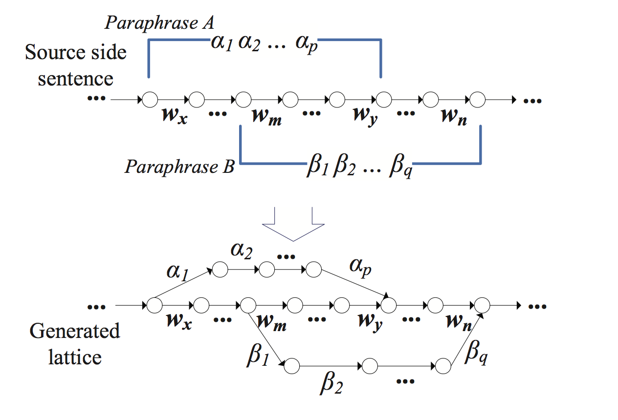
Paraphrases for SMT (2/2)
Paraphrase lattice and lattice decoding [Du+ 2010]
Incorporate as additional training data [Pal+ 2014], which may improve both the coverage and accuracy

Slide 16
Proposed Method
Phrase table
f₁ ||| e₁ ||| φ(f₁|e₁) lex(f₁|e₁) …
F1(f₁,e₁) F2(f₁,e₁) …
f₂ ||| e₂ ||| φ(f₂|e₂) lex(f₂|e₂) …
F1(f₂,e₂) F2(f₂,e₂) …
f₃ ||| e₃ ||| φ(f₃|e₃) lex(f₃|e₃) …
F1(f₃,e₃) F2(f₃,e₃) …
・ ・ ・
・ ・ ・
f₁ ||| f₂ ||| p(f₁|f₂)
f₁ ||| f₃ ||| p(f₁|f₃)
BLE-based comparable feature estimation
(Vector smoothing with paraphrases)
Parallel corpus
・ ・ ・
BLE-based comparable feature estimation
e₁ ||| e₂ ||| p(e₁|e₂)
e₁ ||| e₃ ||| p(e₁|e₃)
・ ・ ・
Paraphrase
Comparable
corpora

Slide 17
Paraphrase Overlap
Different from synonyms, paraphrases may overlap
It is necessary to consider overlap when using paraphrases for vector smoothing
Overlapped paraphrases’ context, topical and temporal occurrence vectors contain overlapped information
so many years ||| many years
first thing ||| first thing that
mass media , ||| media ,
# Examples from the paraphrases extracted from Zh-En NIST data

Slide 18
Context vector Smoothing with Paraphrases
x and x_{i} may overlap
Combined vector
n: a set of paraphrases for phrase x
Frequency
Phrase x’s
vector
Paraphrase
probability
Paraphrase’s vector
unemployment figures: <rising: 2.37, economic: 0, recession: 3.94・・・>
Smoothing
unemployment figures: <rising: 0.03, economic: 0.06, recession: 0.04・・・>
Note that smoothing is done for both source and target vectors

Slide 19
Topical and Temporal Occurrence Vector Smoothing with Paraphrases
Combined vector
n: a set of paraphrases for phrase x
x and x_{i} may overlap
Phrase x’s
vector
Paraphrase
probability
Paraphrase’s
vector
unemployment figures: <Topic1: 0, Topic2: 1, Topic3: 0・・・>
Smoothing
unemployment figures: <Topic1: 0.12, Topic2: 1.27, Topic3: 0.05・・・>

Slide 20
Dataset
Parallel corpus: Zh-En NIST (991k sentences) (contextual similarity)
Comparable corpora:
Zh-En Wikipedia (248k article pairs) (topical similarity)
Zh & En Gigaword 5.0 (temporal similarity)
Seed dictionary: Zh-En NIST translation lexicon (82k entries)

Slide 21
MT Experimental Settings
Training: Zh-En NIST parallel corpus (991k sentences)
Tuning and testing: NIST MT02 (878 sentences with 4 references) and NIST MT03 (919 sentences with 4 references)
Decoder: MOSES [Koehn+ 2007] (Zh to En translation)
Language model: 5-gram LM trained with SRILM on the En side of the parallel corpus
Compared MT performance by appending the comparable features to a baseline system

Slide 22
MT Results
†‡
†
†‡
BLEU-4
‡
※ Baseline: does not use comparable features
※ +Contextual, +Topical, +Temporal and +All: append contextual, topical and temporal features respectively and all the three types of features
※ “†” and “‡” denote that the result is significantly better than Baseline and Klementiev+ respectively at p < 0.05

Slide 23
Examples of Comparable Feature Scores
f | e | Contextual | Topical | Temporal
失业人数 | unemployment figures | 1.4e-06 | 1e-07 | 0.1942
失业人数 | number of unemployed | 0.0144 | 1e-07 | 0.0236
失业人数 | . unemployment was | 0.0107 | 1e-07 | 0.0709
失业人数 | unemployment and bringing | 1e-07 | 1e-07 | 1e-07
※ Estimated by [Klementiev+ 2012]
f | e | Contextual | Topical | Temporal
失业人数 | unemployment figures | 0.0749 | 0.5434 | 0.4307
失业人数 | number of unemployed | 0.0522 | 0.1907 | 0.5983
失业人数 | . unemployment was | 0.0050 | 0.0117 | 0.0967
失业人数 | unemployment and bringing | 5.1e-05 | 1e-07 | 0.0073
※ Estimated by our proposed method

Slide 24
Conclusion
We improved SMT accuracy using BLE with paraphrases to estimate comparable features from comparable corpora
Future Work
Generate paraphrases from external parallel corpora and monolingual corpora
Apply our method other SMT models

